Slide 1
Big Data, A.I. and Investing
Ken Liu

Slide 2
Deep & Reinforcement Learning
Neural Network & Deep Learning
Convoluted Neural Network (CNN)
Reinforcement Learning
Investment and Trading Strategies
Challenges of applying deep learning
Deep Learning Tools, APIs
Final Assessment Presentations
Limitations, Trends and Futures
Summary of the courses
Thoughts and Discussions on Big Data, AI, Investing

Slide 3


Deep Learning - Example
Colorize Black & White Photos
http://demos.algorithmia.com/colorize-photos/
http://richzhang.github.io/colorization/
Cloud hosted deep learning models on Algorithmia. The Colorful Image Colorization microservice is a computer vision algorithm trained on a million images from the Imagenet dataset.

Slide 4
Deep Learning – AlphaGO
Mastering the game of Go with deep neural networks and tree search
https://deepmind.com/research/alphago/
https://storage.googleapis.com/deepmind-media/alphago/AlphaGoNaturePaper.pdf
https://github.com/Rochester-NRT/RocAlphaGo
AlphaGo Zero - Mastering the game of Go without human knowledge
https://www.nature.com/articles/nature24270.epdf?author_access_token=VJXbVjaSHxFoctQQ4p2k4tRgN0jAjWel9jnR3ZoTv0PVW4gB86EEpGqTRDtpIz-2rmo8-KG06gqVobU5NSCFeHILHcVFUeMsbvwS-lxjqQGg98faovwjxeTUgZAUMnRQ
https://github.com/gcp/leela-zero

Slide 5
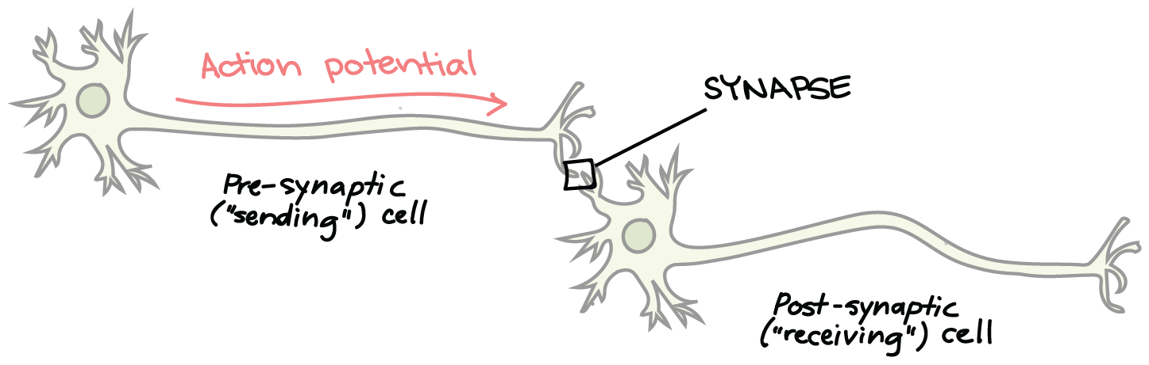
Deep Learning – Neural Networks
Connectionism inspired by the biological neural networks that constitute animal brains
Contrast this to Symbolic, Cognitive, Statistical and Evolutionary models (reasoning, generalization etc.)

Slide 6
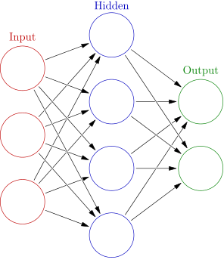
Deep Learning – Neural Networks
ANN (Artificial Neural Network) consists of multiple layers (One Input/ Output and optionally multiple Hidden layers) of Neurons
The neurons are connected from one layer to another. It can be one direction forward (feed-forward), going backward (recurrent) or self connected (feed-back loop)

Slide 7
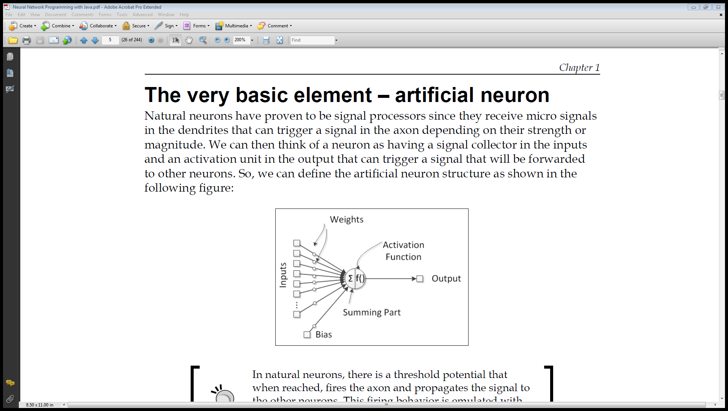
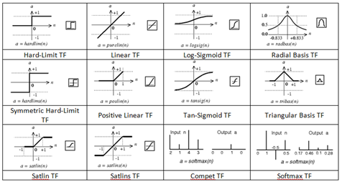
Deep Learning – Neural Networks
From the Input data, the network learn the weight parameters to fit the desired output
Activation functions (non-linearity) determine whether a particular neuron will be active (excitation) or not.

Slide 8
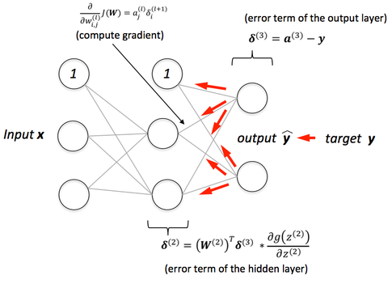
Deep Learning - Neural Networks
Back propagation: calculate the error contribution of each neuron after a batch of data. Used by the gradient descent optimization algorithm to adjust the weight of neurons by calculating the gradient of the loss function.
https://mattmazur.com/2015/03/17/a-step-by-step-backpropagation-example/

Slide 9
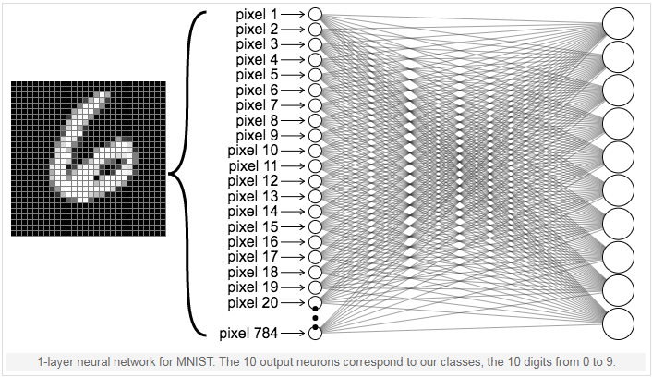
Visualize Neural Network

Slide 10
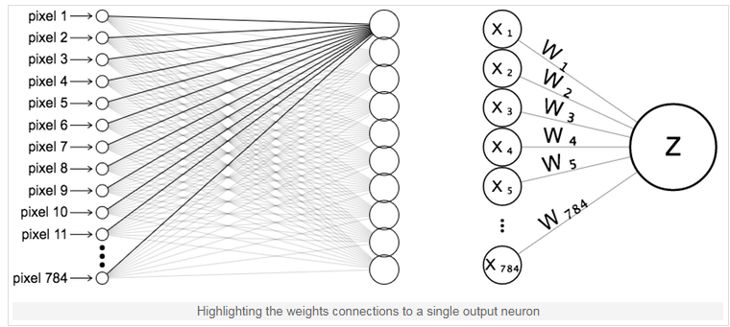
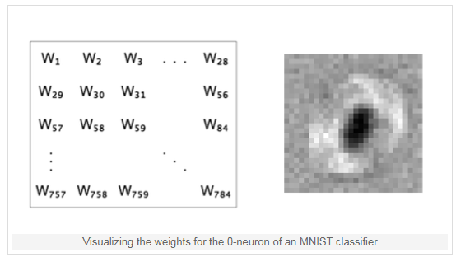
Visualize Neural Network

Slide 11
Deep Learning – Breakthrough
Deep Neural Network (DNN) is a type of Neural Network with many layers. Training used to be time consuming while suffering from the vanishing gradient problem. Hardware improvements (cloud, GPU) and separately pre-trained layers in DNN learning helps mitigate the issues
Hinton, G. E., Osindero, S. and Teh, Y (2006). A fast learning algorithm for deep belief nets Neural Computation 18, pp 1527-1554
Neural Network (Deep Learning in particular) is easier to scale by adding neurons and layer to increase the model capacity to take on more complex problems comparing to other analytic models. (any problem here?)
http://playground.tensorflow.org
http://cs.stanford.edu/people/karpathy/convnetjs/

Slide 12
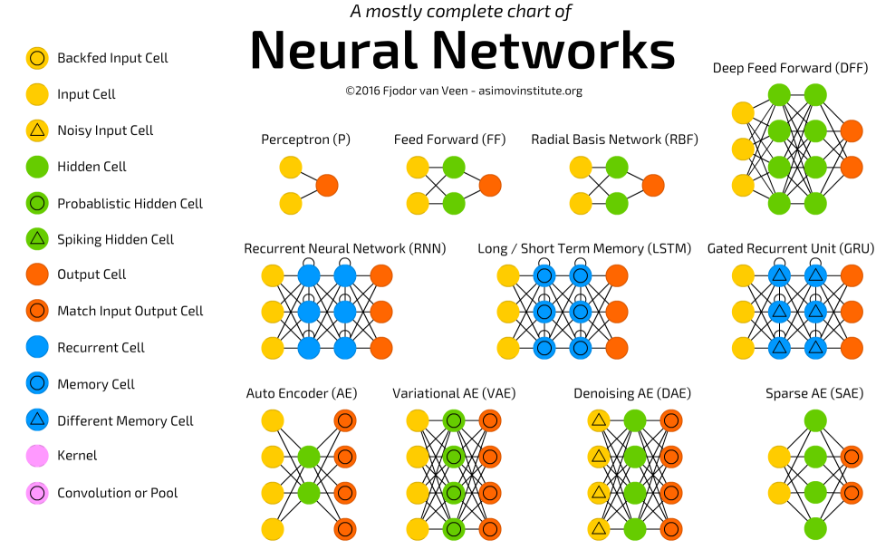
Deep Learning - Types
Long Short-Term Memory (LSTM) and Recurrent Neural Networks (RNN) are designed for sequence modeling.
They should be a good choice to model time series data

Slide 13
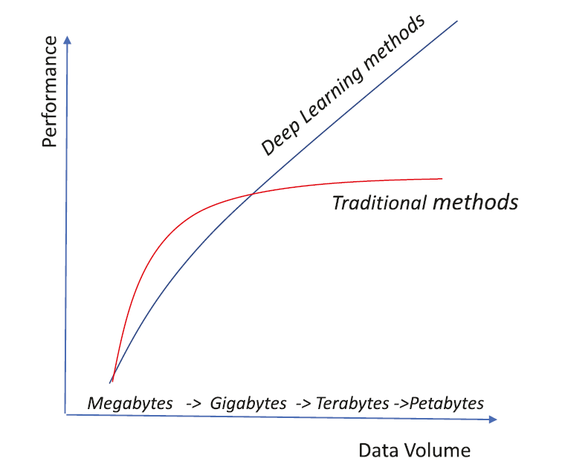
Deep Learning vs Other Machine Learning
Deep learning tend to have a lot of parameters, hence requires sufficiently large volume of data to train and more computation power
When the data volume is less, traditional methods tend to perform better that deep-learning ones. However, when the data volume is huge, the deep-learning method wins over traditional methods. (Hence Deep Learning is more scalable)
Ref: The Number of Hidden Layers

Slide 14
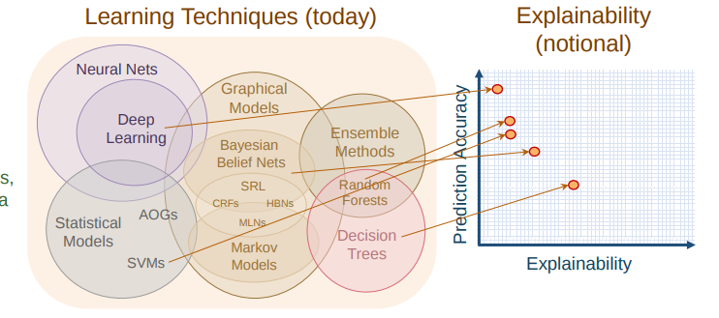
Deep Learning vs Other Machine Learning
Deep learning tend to have a lot of parameters, however, it is hard to explain why the model adapt to certain heights. It’s sometimes called black-box model and hard to explain the decision (e.g. comparing to the decision trees)

Slide 15
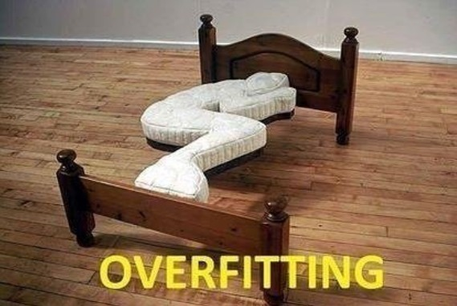
Deep Learning vs Other Machine Learning
Deep Learning model can scale easily and with thousands or million parameters to model. It’s very powerful but the problem is……….

Slide 16
Deep Learning – CNN
Convolutional Neural Networks (CNN) for Visual Recognition
http://cs231n.stanford.edu/
https://www.youtube.com/watch?v=vT1JzLTH4G4&list=PLC1qU-LWwrF64f4QKQT-Vg5Wr4qEE1Zxk
The most accurate image recognition technique and win the ImageNet (Image database just like the corpus to the text data) competition
http://www.image-net.org/

Slide 17

Deep Learning – CNN
CNN’s image representation at different layers is similar to how the brain processes visual information
Human sees structure/region (not pixel)
Use convolution in place of general matrix multiplication in at least one of their layers to learn the feature in a region

Slide 18
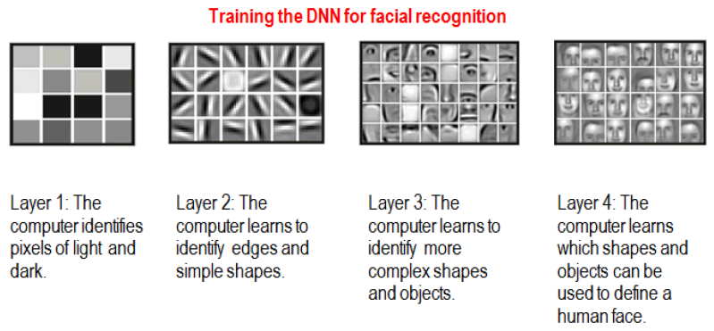
Deep Learning – CNN

Slide 19
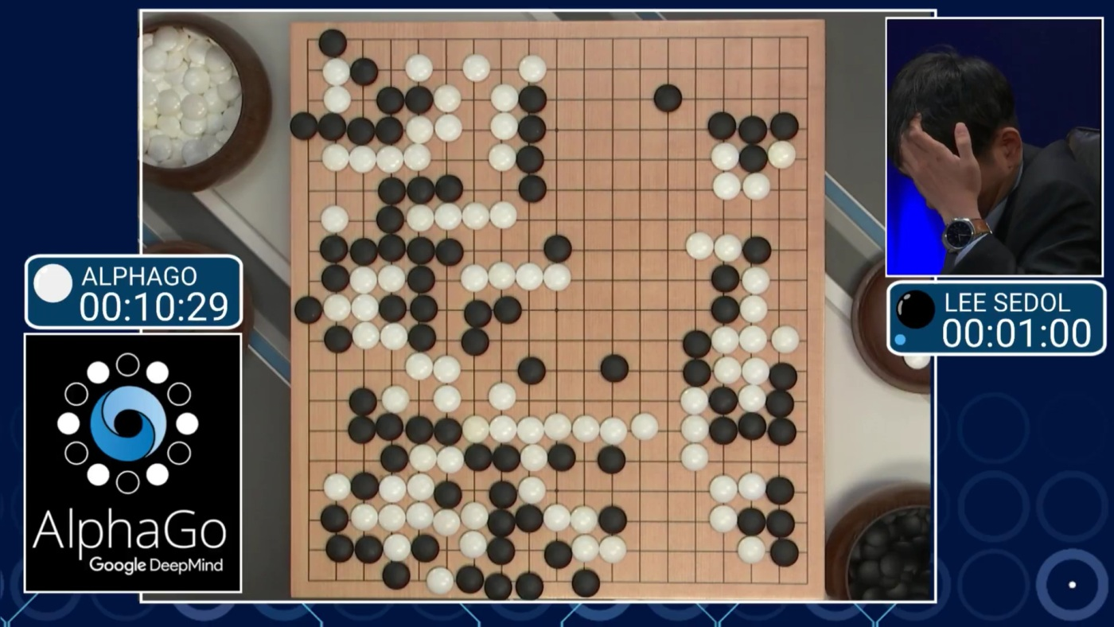
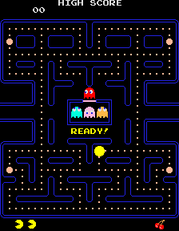
Reinforcement Learning
https://cs.stanford.edu/people/karpathy/convnetjs/demo/rldemo.html

Slide 20

Reinforcement Learning
Software agents to take actions in an environment so as to maximize some notion of cumulative reward to achieve the objective.
The feedback (rewards or punishments) can be delayed.
Explore vs. Exploit: should the algorithm explore new alternative actions that may maximize the final reward, or stick to the established one that maximizes the immediate reward.
Value learning (state, values) vs Policy learning

Slide 21
Reinforcement Learning
Q-function learns all the possible combination of the states and actions, hence the size of the Q-table (state, values) will be very big
Train the neural network to approximate the Q-function
DeepMind’s work on Deep Q-Network -uses a deep neural network that takes an image (the state) in to estimate the Q-value for all possible actions.)
Deep Reinforcement Learning: https://www.youtube.com/watch?v=lvoHnicueoE
Quotes: Sometimes, we talk about reinforcement learning, which is a little bit like how you might train a puppy. The dog does something good, and you go, “Good dog.” It does something bad, and you go, “Bad dog.” And over time, the dog figures out what it did well, what it did poorly, and hopefully does more of the good things.
Supervised Learning -> Relationship (Classification/Regression); RL learns Action (Policy)

Slide 22
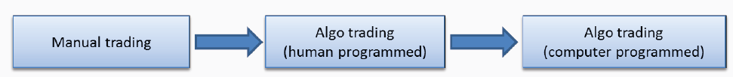
Reinforcement Learning Application
Example of Reinforcement Learning based Algo Trading System
JP Morgan LOXM
http://www.smallake.kr/wp-content/uploads/2017/08/Active-Learning-in-Trading-Algorithms.pdf
ITG ISai (Implementation Shortfall Artificial Intelligent)
(It is a very black box approach and may not be welcomed by compliance and regulators)

Slide 23
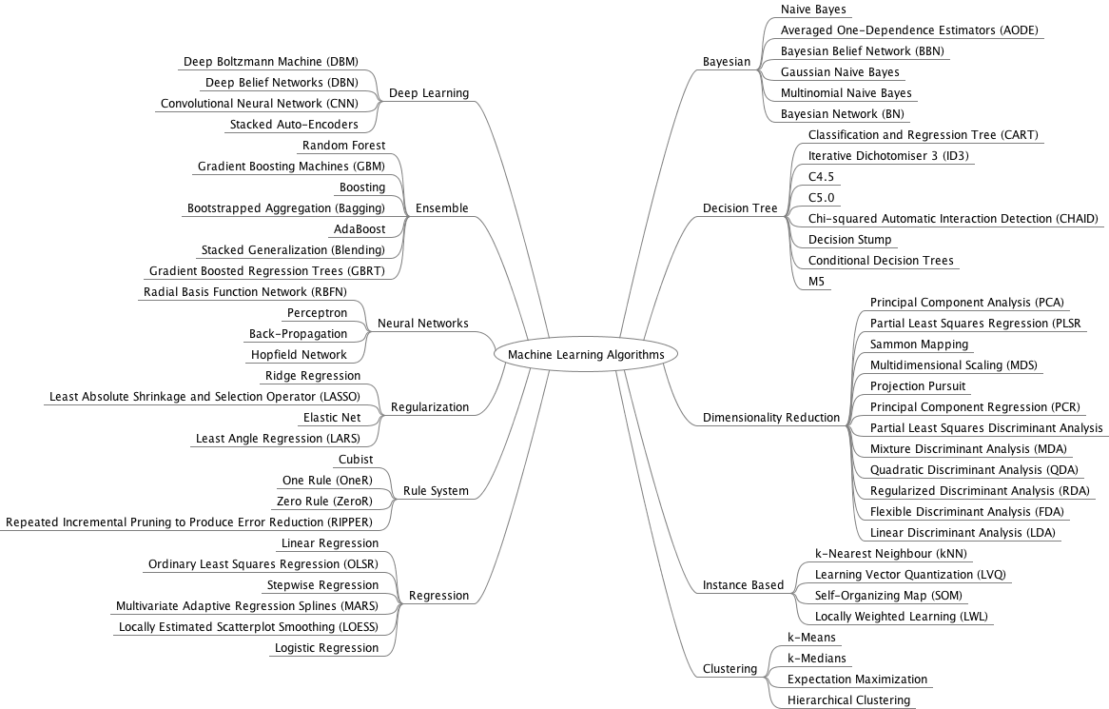
Summary of the Algorithms

Slide 24
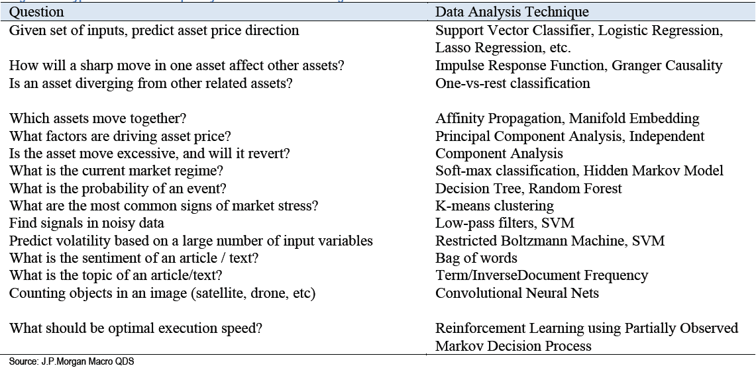
Summary of the Usages

Slide 25
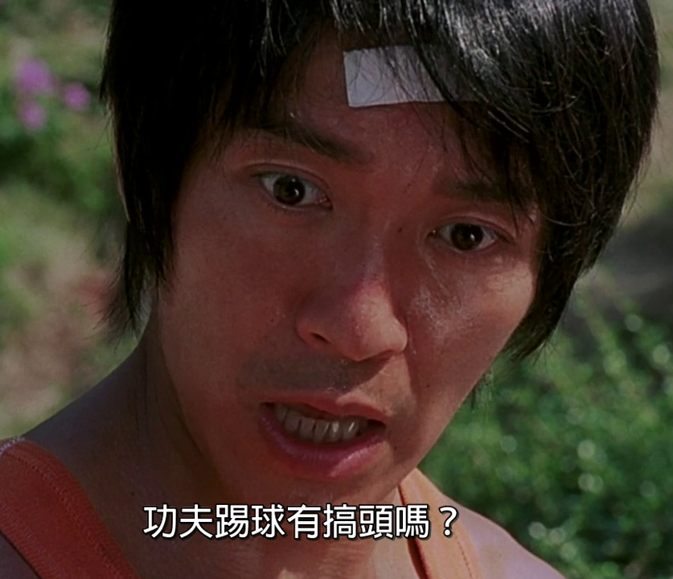
Trading Strategies - Background
AI + Trading = Success ?

Slide 26
Trading Strategies - Biz
Quant (contrast to value/fundamental) trading based on AI and Machine Learning
Productizing the trading strategies into a global AI volatility fund to seek intraday profits in futures, options, ETF and other low transaction cost instruments which are listed products in global exchanges
In 2014, Man Group bought Boston-based hedge fund Numeric for USD$325 million at 8 times Price-Earnings-Ratio
https://dealbook.nytimes.com/2014/06/19/man-group-to-buy-bostons-numeric-holdings/

Slide 27








Trading Strategies - Biz
Competitor Analysis
Stock Picking
Robinhood
Brokerage
Asset Manager
ETF

Slide 28
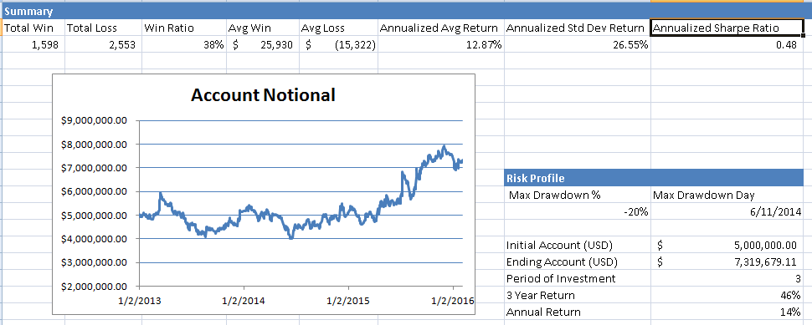
Trading Strategies – Fee Structure
2% management fee of net asset value (NAV) and 20% performance fee of fund’s profit (aka 2/20). Performance fee is subjected to a high water mark scheme. No hurdle rate (min. rate of return before collecting performance fee) is applicable.

Slide 29
Trading Strategies – Fee Structure
High-Water Mark: the highest peak in value that an fund. It prevents performance-based fees charged twice for the same amount of performance. Example: $500,000 of 20% Performance fee
First month, the fund earns a 15% return; 20% fee on this $75,000 gain, which equates to $15,000. At this point, the high-water mark $575,000
Second month, loses 20% to $460,000.
Third month, earns a profit of 50%: $460,000 to $690,000.
With a high-water mark in place, all gains from $460,000 to $575,000 are disregarded.
But gains above the high-water mark are subject to the performance-based fee. 20% on the gains from $575,000 to $690,000, which is an additional $23,000.

Slide 30
Trading Strategies - Drivers
Rule based trading strategies is rigid and unable to adapt to new conditions as they are handcrafted by domain experts with higher difficulties in interpretation on large amount of data.
Using data-driven approach has the following advantages.
learn the rules from the data itself instead of being handcrafted beforehand
allow the discoveries of rules that suit different scenarios
the rules can be adjusted according to the changes in conditions (re-training or parameters tuning).

Slide 31
Trading Strategies - Workflow

Slide 32
Trading Strategies - Workflow
Raw Data: sourced from data providers (such IB, HKEx). It has to be comprehensive that covers different markets and across many years in order to learn the relationship and back test the trading strategies.
Data Processing: derive features from raw data (such as bid/ask spread and imbalance, queue size, short term money flow from the historical tick data). Pre-process the data, for instance, adjusting the price from corporation actions or holiday.
EDA (Exploratory Data Analysis): analyze/visualize (e.g. scatter plot) the data sets to summarize their main characteristics and relationships. Depends on the objective of the particular trading strategy, not all the features will be useful to feed into the machine learning models. Together with our domain knowledge on market dynamics and microstructure, we apply the EDA techniques to pick the relevant features.

Slide 33
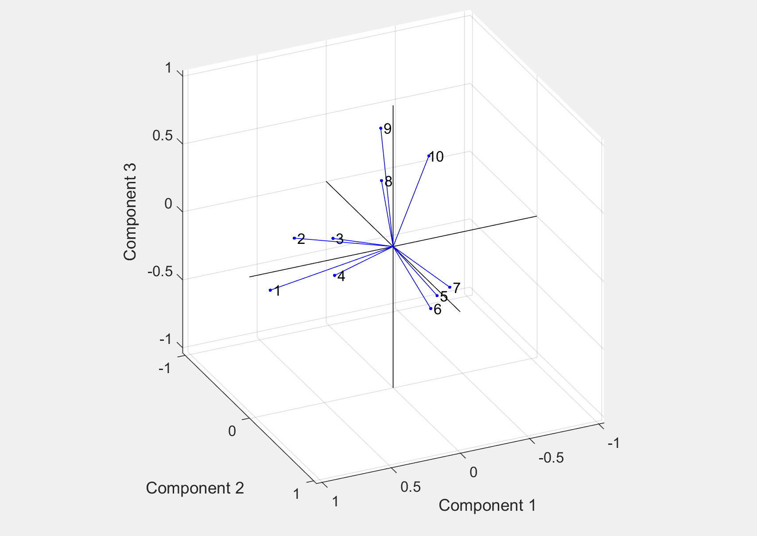
Trading Strategies - Workflow
Feature Extraction / Clustering: feature extraction/clustering to systematically group or reduce the feature set which simplify the underlying model and ease the computation time. It will also decrease the chance of over-fitting.
This example is using Factor Analysis to group 10 different features to 3 important components. Therefore, instead of feeding 10 features to the machine learning model, we only need to use 3 components (linearly combined features) which are already captured the essential

Slide 34
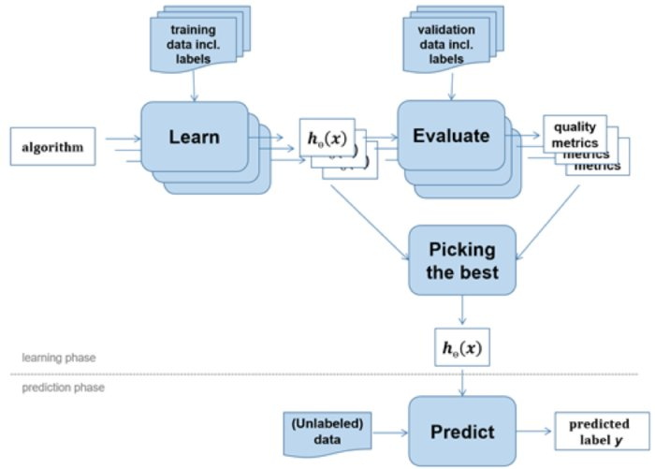
Trading Strategies – Workflow
Machine Learning
Choose Algorithm
Train (Learn) the model from data
Tune hyper-parameters
Evaluate the accuracy
Used the trained model for prediction

Slide 35
Trading Strategies – Workflow
Back Testing: use historical data to evaluate the trading strategies performance, P&L and Win Ratio
Prevention of Data Snooping Bias: is a common mistake in trading strategy simulation where an algorithm makes a forecast based on information in the future, as full price history is already made available to the simulation. One way is to replay market data tick by tick into the algorithmic trading engine. The idea is to mimic real life trading, where one have no knowledge about what’s going to happen next, and would need to make decision with only data available up to this moment in time. Replay market data tick-by-tick is slow (e.g. running with one year data).
Market Impact: it is hard to model the market impact caused by your trade as it’s obviously not happened historically !

Slide 36
Trading Strategies - Risk Management
Maintain sustainability of the trading strategies, and to prevent catastrophic events (such as program bugs or extreme market conditions) that could cause significant loss to the portfolio. This is to guarantee that the trading strategies do not lose more than a prefixed amount or a percentage of Asset Under Management.
Strategy Stop Loss: on a per strategy basis, every time the strategy goes into a position, a stop loss order is automatically created. The strategy can only tolerate a certain amount of unrealized loss, before the position is automatically cut.
Daily Stop Loss: on an overall portfolio level, once the daily loss reaches the daily stop loss limit, the system is forbidden to establish any new positions, and any existing positions is automatically closed.

Slide 37
Trading Strategies – Transaction Cost
Transaction cost is a big part in Quant trading because of the frequency of buying and selling instruments that needs to pay the fees
HK Stock: http://www.hkex.com.hk/services/rules-and-forms-and-fees/fees/securities-(hong-kong)/trading/transaction?sc_lang=en
Brokerage Fee: 0.25% of transaction amount or minimum HK$100 (depends on brokers and some claim to be free)
Transaction Levy: 0.0027% of transaction amount
Trading Fee: 0.005% of the transaction amount
Stamp duty (collected for HKSAR Government): 0.1% of transaction
HK Index Future HK$15 per contract offered by IB
(Note: To realize the profile (or loss), it involves buy/sell and hence needs to counts the above charges twice)

Slide 38
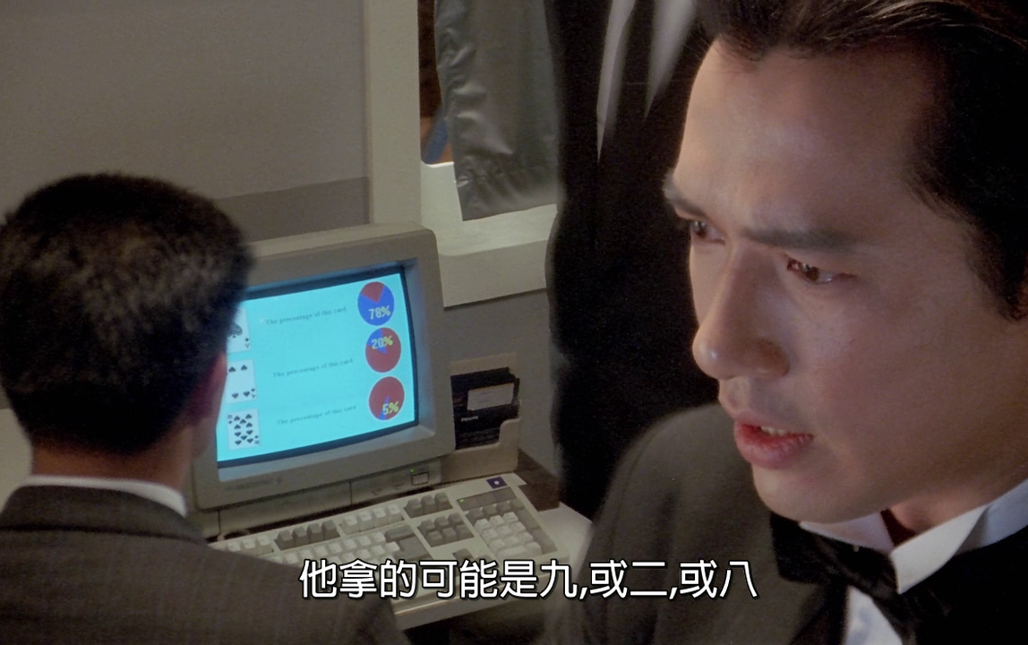
Trading Strategies – Trading Charts

Slide 39
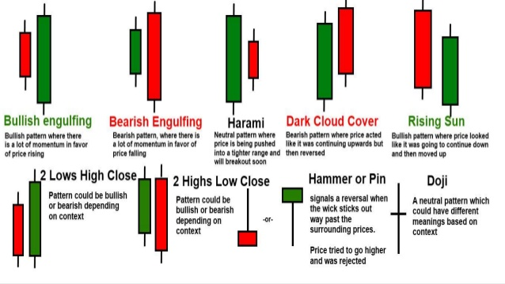
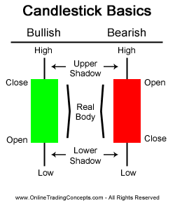
Trading Strategies – Trading Charts
Mimic human traders on analyzing charts like Candle Sticks, RSI and Moving average. Generate useful analytics such as classifying the strength of certain signals, spotting anomaly and learning the underlying patters for future predictions.

Slide 40
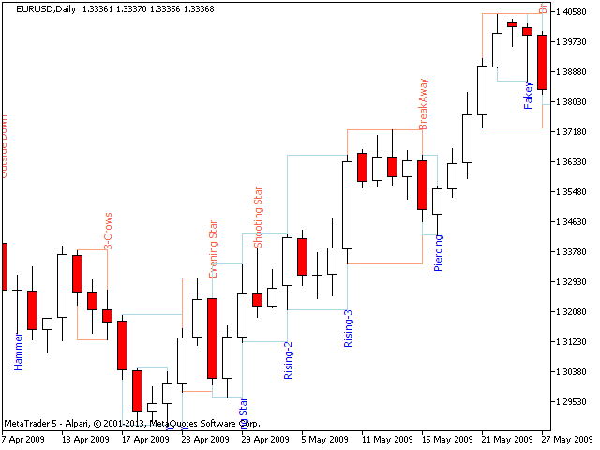
Trading Strategies – Trading Charts
Put Candle Sticks in time series to spot trends
Depends on the duration of the trend (short-term trend or long-term trend), each candle bar can a 1-min bar, 5-min, 15-min etc. and up to 1-year

Slide 41
Trading Strategies – Trading Charts
Analysis on graphs done by artificial intelligence (AI) has the following advantages over the traditional approach of raw data
acts as a way of pre-processing from raw data as graphs can provide better summary while filtering out noises
good way to compress the data which is defined as dimension reduction, allowing “a picture is worth thousand of words”
encodes domain knowledge such as feature engineering when generating the trading graphs
mimics how human processes information by visually capturing the spatial and temporal relationships.
AI can learn more and faster

Slide 42
Trading Strategies - Trading Charts
Modules: Chart Generator, CNN Clusterer, Classifier, CNN Visualizer and Deep-Q trading.
Traning Data & Features
CNN Visualizer
Historical Tick Data
Chart Generator
CNN Clusterer
Classifier
Deep-Q trading
Human Label

Slide 43
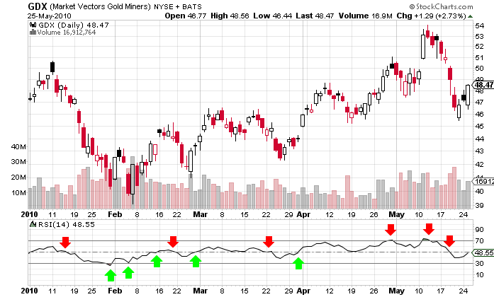
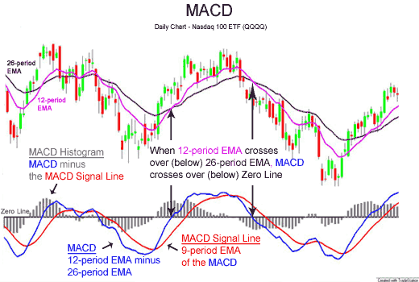
Trading Strategies - Trading Charts
Chart Generator: read from raw financial data / feature set to generate trading charts. Has plug-in of different modules to generate different types of charts. By inputting raw historical data such as volumes and prices into Chart Generator, it will convert the data into corresponding technical graphs such as MACD, RSI apart the Candle Sticks.

Slide 44
Trading Strategies - Trading Charts
CNN Clusterer: categorizes the charts into different categories which has similar patterns. Currently, it requires human to label (e.g. sudden move, flat tail etc.) the main characteristics from the clustered group of the output charts.
CNN techniques will be applied to cluster the graphs into different groups and to train the model to classify the graphs for similar patterns (unsupervised learning)
CNN learns the spatial relations of images which are the features that will be used for clustering the graphs. CNN also learns the hierarchical relation of the graphs for classification purpose.
CNN Visualizer: visualization techniques to see the captured patterns in different layers of the CNN model and hence, help to understand the models.

Slide 45
Trading Strategies – Reinforcement Learning
Challenges in Supervised Learning on price movement:
No liquidity in the best order book levels, network latencies, and fees, none of which the supervised model could take into account.
It does not imply a policy: what if the price had moved down? Would you have sold? Kept the position and waited? What if the price had moved up just a little bit and then moved down again? What if we had been uncertain about the prediction, for example 65% up and 35% down? Would you still have bought? How do you choose the threshold to place an order?
Need a rule-based policy that takes as input your price predictions and decides what to actually do: Place an order, do nothing, cancel an order, and so on

Slide 46
Trading Strategies – Reinforcement Learning
Reinforcement Learning
http://www.wildml.com/2018/02/introduction-to-learning-to-trade-with-reinforcement-learning/
https://github.com/ucaiado/QLearning_Trading
Instead of needing to hand-code a rule-based policy, Reinforcement Learning directly learns a policy.
Trained directly in Simulation Environments
Ability to model other agents
(AI Traders -> Repeatedly Doing Backtest -> Find the Optimal Strategies)

Slide 47
Trading Strategies – Reinforcement Learning
Deep Q trading: http://cslt.riit.tsinghua.edu.cn/mediawiki/images/5/5f/Dtq.pdf
reinforcement learning (RL) and Q-learning, can learn decision rules directly with reasonable rewards/punishments
has been successfully applied to some challenging tasks like game playing and robot motion.
automatically determine what position to hold at each trading time.
Deep Stock Representation Learning: From Candlestick Charts to Investment Decisions: https://arxiv.org/abs/1709.03803

Slide 48
Deep Learning Tools & APIs
TensorFlow
https://www.tensorflow.org/
Keras
https://keras.io/
Open AI Gym
https://github.com/openai/gym

Slide 49
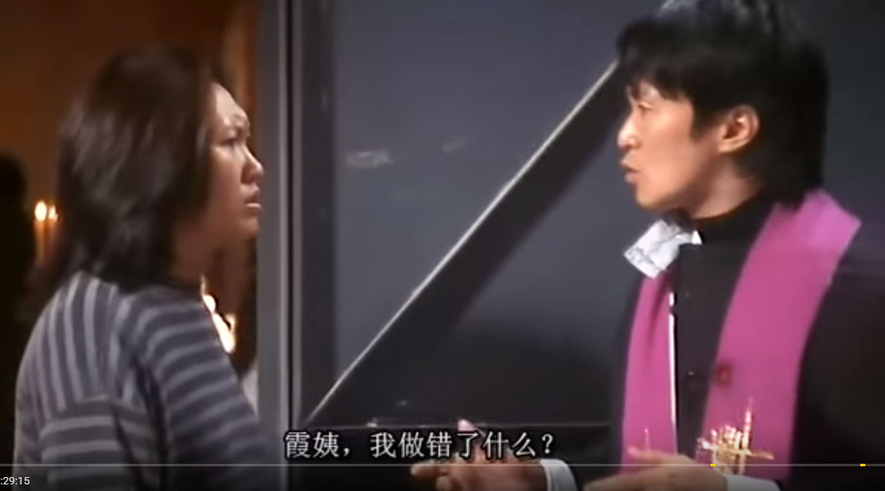

Challenges

Slide 50
Challenges
Historical market data cost: used for model training and back testing. It is expensive to buy historical data (especially tick data). But Deep learning is a data hungry model and need a lot of data to discover meaningful signals
Data and Features: Too less data (not able to explain) may suffer curse of dimensionality (recall SVM kernel function example) where the prediction lack statistical significance. Or too much data (noise?) and financial data is traditionally with very low signal-to-noise (compare to Image Analysis)
Infrastructure cost: low latency trading requires fast (and hence expensive) market data and trading infrastructure
Transaction costs: quant trading has high number of transactions that amount to large fees that eats up the profile

Slide 51
Challenges
Prediction timeframe: shorter term is more accurate, but is less profitable due to the transaction costs to realize the profile
Data Processing Time: spend 80% of (active) time to prepare the data correctly (training models also needs time and but just let the computer run while going for lunch)
Correlation vs Causality: correlation does not imply causation. If two stocks move in a correlated fashion, it doesn’t necessarily mean stock A causes the Stock B to move. It could both be under another common factor.
Stochastic (Randomness): confused supervised learning model. Is trading really a random walk or we need more features (factors) to train the model

Slide 52
Challenges
Time and cost for model training: machine learning (especially Deep Learning) is a black box and sometimes difficult to reason the training results and require trial and errors (e.g. hyper-parameters tuning). The time to train and re-train a model with large data set is very time consuming and require extra expense to rent the powerful machine (with many GPUs) in the cloud
Financial products: financial instruments (especially derivative products) are linked or correlated in a complex fashion that adds volatility or uncertainties
All-or-nothing: develop a profitable trading strategy is an all-or-nothing exercise and which create mental pressure

Slide 53
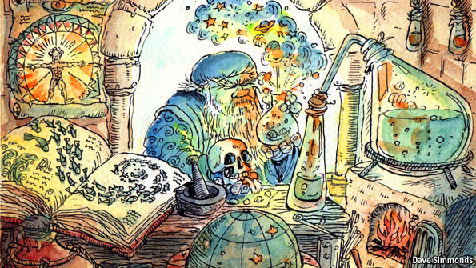
Challenges
Overfitting: in-sample training gives high accuracy (false hope) but out-sample accuracy drops significantly
Like Modem Alchemy and just pray it works

Slide 54
Final Presentation – AI Application
Describe your problem.
What data and (learning) model are you going to use?
Why do you choose the above data and model?
Describe the Machine Learning workflow
Advantages and challenges of applying AI to your problem
(Verbally) share your thoughts on the impact of AI to you (work, life) and society in general

Slide 55
Limitation of Deep Learning
Everything is a vector (is a point in a geometric space). Each layer in a deep learning model operates one simple geometric transformation on the data that goes through it.
This complex transformation attempts to maps the input space to the target space, one point at a time. This transformation is parametrized by the weights of the layers, which are iteratively updated based on how well the model is currently performing.
A key characteristic of this geometric transformation is that it must be differentiable, which is required in order for us to be able to learn its parameters via gradient descent. Intuitively, this means that the geometric morphing from inputs to outputs must be smooth and continuous—a significant constraint.

Slide 56
Limitation of Deep Learning
Turning meaning into vectors, into geometric spaces, then incrementally learning complex geometric transformations that map one space to another. All you need are spaces of sufficiently high dimensionality in order to capture the full scope of the relationships found in the original data
Deep learning models do not have any understanding of their input, at least not in any human sense.
Our models can only perform local generalization, adapting to new situations that must stay very close from past data, while human cognition is capable of extreme generalization, quickly adapting to radically novel situations, or planning very for long-term future situations.

Slide 57

Limitation of Deep Learning
What’s that mean, in layman term please
Deep Learning doesn’t have a human-like intelligent. It’s just a very good “mapper” (mapping input to output)
Doesn’t have reasoning (i.e. cannot generalize well, NOT一理通,百理明)
Because of that, it needs a lot of data to learn a specific task (compare this to how a people learn to cross the road)

Slide 58
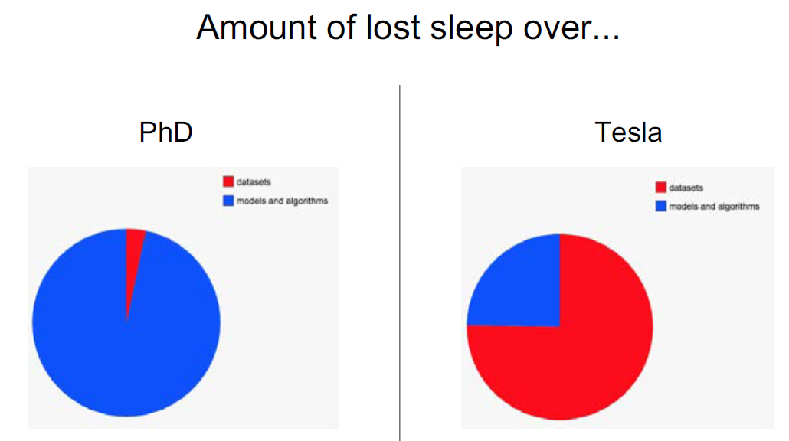
Telsa Example – Data labelling
Based on “Building the Software 2.0 Stack – by Andrej Karpathy, May 10, 2018 (page 51 – 75)

Slide 59
Trends and Futures
GAN: Generative Adversarial Network
Visualization: able to peek into different layers of deep learning and understand more what features has been learned
Feature Visualization: https://distill.pub/2017/feature-visualization/
Tensor Process Unit (TPU): specific hardware dedicated for deep learning
https://en.wikipedia.org/wiki/Tensor_processing_unit
Unsurprised learning: learn without labelled data, for example, AlphaGo Zero
Quantum Computer: massive parallel processing machine
Renaissance, DE Shaw look to quantum computing for edge: https://www.ft.com/content/60fded2a-be5a-11e7-b8a3-38a6e068f464

Slide 60
Summary of the courses - Big Data
Data stores in more than one computer and distribute across the network. Hash function and map-reduce are the key techniques.
Transactional (read/write) vs Data Warehouse (mostly read)
SQL vs NoSQL:
NoSQL scheme-on-read: more flexible in data format
Relax RDBMS-SQL (ACID) and only require eventual consistency for better performance across the network
Inverted Index for fast data look up and PageRank (Google) for scoring
Typical workflow: extract -> store -> pre & post process -> index -> query -> visualize

Slide 61
Summary of the courses - Sentiment
Sentence vs Document vs Aspect level
TRMI (Thomson Reuters MarketPsych Indices) for Sentiment Trading:
Z-scores: sentiment delta or rate of change
Decision Tress: conditioned on fundamental or technical factors
MACD: sentiment moving average
NLP:
Core building blocks: N-Gram, POS, NER, Co-reference, Tokenization, Stemming
Applications: sentiments, information extraction, text similarity
Data: Corpus, TreeBank
Models: HMM, Dependency Network, word2vec

Slide 62
Summary of the courses – Algo Trading
Algo Trading, Program Trading, HFT, Dark Pool, Co-location
Execution Algo Strategies: VWAP, TWAP, POV, Implementation Shortfall, MOC, Pairs, Market Making
Trading Signals: Order Book Imbalance; Money Flow
Exchange Rules: order type, open/close auction, volatility auction, price range, tick size, lot size
Order Book: Bid/Ask price and size, last price, trade size

Slide 63
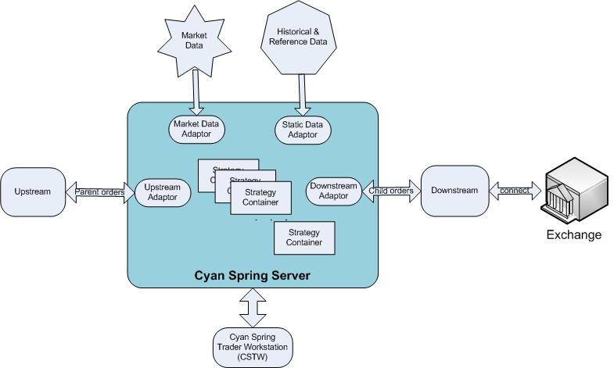
Summary of the courses – Algo Trading

Slide 64
Summary of the courses - AI
State Space Search, Knowledge Representation
Machine Learning: Data + Hardware + Algorithm = Model for Prediction
Applications: Pattern Recognition, Classification, Anomaly Detection, Recommendation
Supervised, Unsupervised
Data: Training Data, Validation Data, Test Data,
Algorithms: Linear Regression, SVM, Decision Tree, Navies Bayes, PCA
Accuracy: type-1, type-2 errors, ROC curve
Objective Function, Gradient Descent,
Overfit, Class Imbalance, Regularization
(Side Bar: Is Investing/trading more Frequentist or Bayesian?)

Slide 65
Summary of the courses - Reference
2017 The State of Data Science& Machine Learning
https://www.kaggle.com/surveys/2017
J.P.Morgan’s massive guide to machine learning and big data jobs in finance
https://news.efinancialcareers.com/hk-en/285249/machine-learning-and-big-data-j-p-morgan/
2017's Deep Learning Papers on Investing
https://itnext.io/2017s-deep-learning-papers-on-investing-7489e8f59487
Why is machine learning in finance so hard
https://www.hardikp.com/2018/02/11/why-is-machine-learning-in-finance-so-hard/

Slide 66
Thoughts and Discussions
AI complements (rather than replace) human in many aspects
More domain knowledge input on feature discovery or let data speak itself?
Capacity vs Model limitation and are we reaching the model limit yet?
Is quant trading a waste of time (excessive trading)? Why don’t we just buy and hold nVidia and Tencent?
Become addictive
Consistent profits (many small bets to have stale mini-profiles)
Market data is the result and Sentiment is the cause?

Slide 67
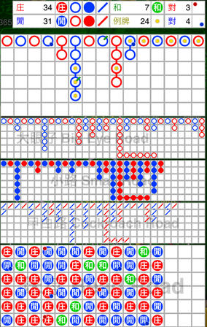
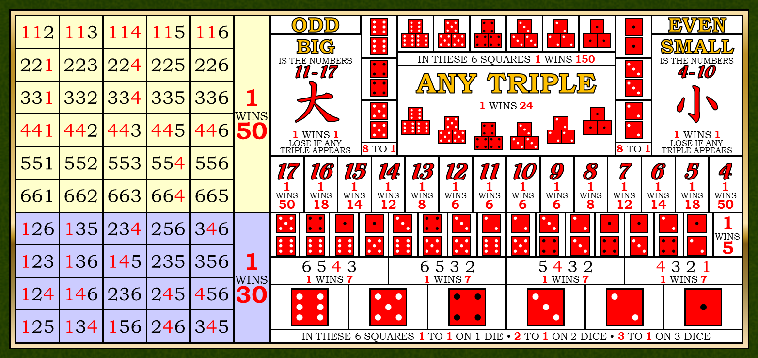
Thoughts and Discussions
Regime Shifting: are trends/patterns stationary and bound to be repeating?

Slide 68
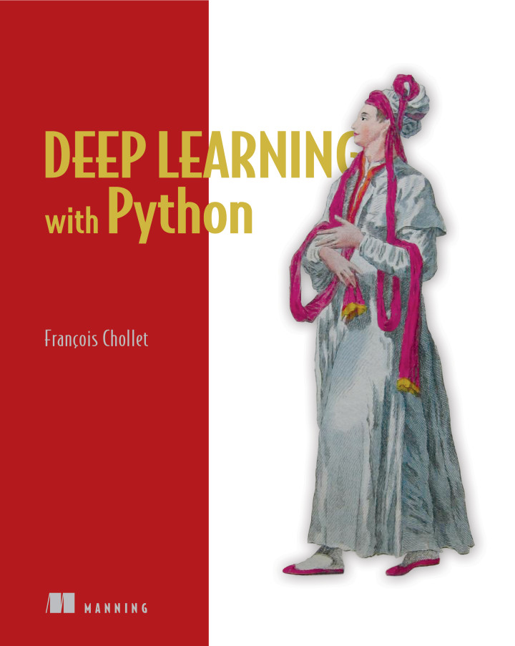
Thoughts and Discussions
Deep Learning with Python book p.224
Markets and Machine Learning
Some readers are bound to want to take the techniques we’ve introduced here and try them on the problem of forecasting the future price of securities on the stock market (or currency exchange rates, and so on). Markets have very different statistical characteristics than natural phenomena such as weather patterns. Trying to use machine learning to beat markets, when you only have access to publicly available data, is a difficult endeavor, and you’re likely to waste your time and resources with nothing to show for it.
Always remember that when it comes to markets, past performance is not a good predictor of future returns —looking in the rear-view mirror is a bad way to drive. Machine learning, on the other hand, is applicable to datasets where the past is a good predictor of the future.

Slide 69
Thoughts and Discussions
AI and Machine in trading & investment are in early stage comparing to other areas like image recognition, NLP
People are (much) smarter but machines work (much much) harder. Is it a race between rabbit & tortoise or 三個臭皮匠，勝過一個諸葛亮 (3 idiots are better than one smart guy)?
AGI (Artificial General Intelligence): machine is not real human-like intelligence “yet” but are you going to achieve true Intelligence?
Biologist Emerson M. Pugh once said, “If the human brain were so simple that we could understand it, we would be so simple that we couldn’t”

Slide 70

Thank you

